Slide 1
Maine State
AVIATION SYSTEM PLAN
Survey Result Discussions
Overview for Maine Aeronautical Advisory Board
June 10th, 2020

Slide 2
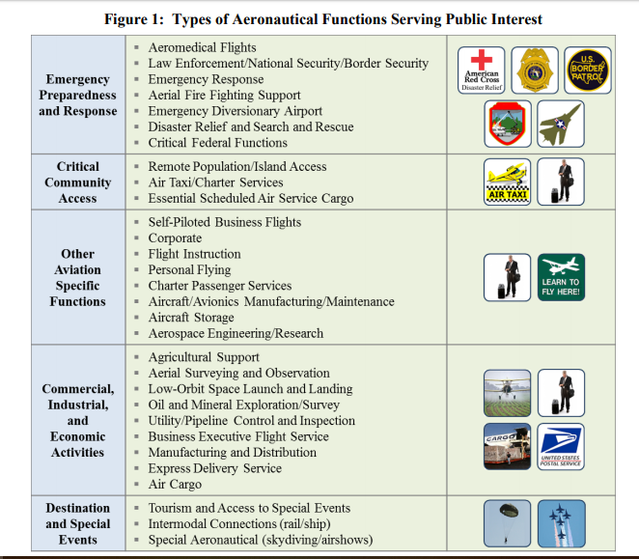
Airport Functions Quantitative Ranking
Each SASP Airport serves a role and function in the system, which is a based upon existing users, activity types, and location. We know that many airports perform the same functions, but we also know that many of these activities vary in frequency and scale. So we will be asking each Airport to rank the level of activity within each function shown at right, and we’ll be asking to confirm or clarify information on these functions and themes gathered in their survey. Questions needed to be asked:
What are the functions of your airport?
Can you provide examples of operators and frequency of use per function?
Does this list cover all your markets? If not, what’s missing?
Can you rank these functions by priority and importance for your airport?
Anticipated changes in functions?
Do you have functions that you would like to see at your airport?
What are your stakeholders concerns for these functions?
Figure 1 is from the FAA ASSET Report and is in no particular order or priority. The SASP may create priorities and
rankings based on these functions.
Notes:
CN

Slide 3
Airport Manager & Stakeholder Survey Themes
The Airport Manager’s surveys provided an abundant amount of information describing their type of facility. The themes were categorized as Maintenance Challenges, Facility Needs, and Additional Services Required.
Conversely, Airport Stakeholder themes viewed things differently. Some themes were shared. Namely, funding and facility needs.
Maintenance Challenges – Airport Managers
Out of 94 responses related to what challenges airport managers are dealing with regarding maintenance:
Snow Removal – 20% was the highest theme.
Facility Development Needs – Airport Managers
Out of 98 responses related to what facility development needs airport managers require:
Hangars – 24.5% was the highest theme.
Additional Services Required – Airport Managers
30 out of 36 Managers believed MaineDOT services provided are sufficient, but those who did not, noted that additional (state only) Grants/Funding are a service / program desired.
Greatest Strength – Airport Stakeholders
Variety, number of airports, and geographical distribution
Natural Beauty
Access to float planes
Air Guard Base Strategic Location
Needs – Airport Stakeholders
Expanded basic levels of service [such as weather reporting, fueling services and facility conditions – (22 mentions)]
Funding (13 mentions)
Expanded educational outreach for younger generations (9 mentions)
Improved collaboration between businesses and government entities (7 Mentions)
Notes:
CN

Slide 4
Regional Economic Development Surveys
Responses from Regional Economic Development Surveys really showed regional differences in terms of respondents’ involvement in airports and aviation. Nearly 100% of respondents had reasons to anticipate increased usage of airports in their region at the time the survey was completed – which was pre-COVID-19.
Regional Aviation Assets Themes
Loring Air Force Base & its proximity to Canada
BGR runway, proximity to highway and port, closest US Airport to Europe
Twitchells (3B5) in Turner; Rangeley Lake (M57) in Rangeley – AVCOG seaplane base assets
Waterville site of Foreign Trade Zone #186
PWM for pax travel/tourism, economic/commerce
Sanford – Life Flight base
Priority Targeted Aviation Investments
The AVCOG Regional Strategic Investments plan and ATRC Major Project Priorities identify improvements to Bethel, Rangeley, Oxford County, and Auburn-Lewiston as priorities.
Directly and indirectly, an airport business park, which includes a TIF district, industrial park, plans for public infrastructure build out.
Waterville (MMCC, GPCOG, SMPDC, AVCOG)
Issues for SASP (most mentioned)
“The Last Mile”/ Multimodal connectivity / Ground Transportation Options
Preservation of small airports (Maintenance/funding/EAS to smaller airports
Promotion of regional airports as alternatives to PWM and BGR
Factors Affecting Use of Aviation in Region
Cost of fuel
UAV
Tourism Air service (2 mentions)
Non-aviation business expansion (4 mentions)
Facilities Lacking:
Public transit connectivity (5 mentions)
Flights to BOS from Presque Isle airport
Complement training facilities for U. of Maine Augusta
Modernized airside facilities (4 mentions)
Improved landside facilities (3 mentions)
Airfield and landside pavement repairs (2 mentions)
Notes:
CN

Slide 5
Upcoming Schedule
Schedule Outline for the Airport visits and completion of Phase I
June 2020
MJ is Developing a detailed work plan outlining interview questions, timeframes, and priority airport.
Anticipating first virtual/phone interview by end of June
September 2020
MJ conducting the analysis of the data obtained from surveys, interviews, and site visits
Preparing for October PAC Meeting
October 2020
Developing presentation and informational packets for PAC group
MaineDOT discussions on where phase 2 is focused
PAC Meeting end of October
July 2020
Conducting Interviews with various airports throughout the Month based on airport availability
Reassessing the work plan based upon data obtained. Justify field visits.
August 2020
Scheduling site visits for 2nd Week of August for those felt justified for in-person presence.
Anticipated Site Visits complete by early September.
November 2020
Compiling the edits/suggestions from PAC into the final reports/deliverable.
Begin scoping of Phase 2
Notes:
CN

